Slide 1
MVP Tutorial
Dimitar Tasev

Slide 2
What is MVP?
Stands for Model-View-Presenter
Design Pattern
Used for development of Graphical Interfaces
There are a lot of similar, but different patterns
MVC – Model-View-Controller
MVVM – Model-View-ViewModel (used in Windows Forms) [1]
Flux – used by Facebook with React [2]

Slide 3
History of MVP
Originated as Model-View-Controller
First published description in 1987 for Smalltalk-80 v2.0 [3]
“The central concept behind the Smalltalk-80 user interface is the Model-View-Controller (MVC) paradigm.”
Evolved into Model-View-Presenter mid-1990s [4]
“Taligent, a wholly-owned subsidiary of IBM, is developing a next generation programming model for the C++ and Java programming languages, called Model-View-Presenter or MVP, based on a generalization of the classic MVC programming model of Smalltalk”

Slide 4
What is the goal of MVP?
“the framework exists to separate the representation of information from user interaction”[5]

Slide 5

How does it work?
Three main components [4][6]
View – User Interface: How does the user interact with my data?
The ‘look’ of the GUI, what the user sees and clicks
Model – Data Management: How do I manage my data?
Does hard sums, e.g. stores references to workspaces, runs Algorithms on them
Presenter – How to show the result of the algorithm in the View?

Slide 6
What do we benefit from MVP?
Separation of components makes them:
Smaller code size per component
Easier to read
Easier to understand
Easier to test
Testing
Allows testing of the logic behind the View
The Real View is not necessary for testing - mocking

Slide 7
Restrictions and Gotchas
Presenters should avoid being `QObject`s
This could have been done have connections with the Presenter
This forces testing to require a QApplication
Usually a problem in C++ (Qt4 only?). You DON’T NEED to do it in Python!
You can connect to functions
Watch out for thread issues if using ADS/Algorithm/etc Observers!

Slide 8
Restrictions and Gotchas
Models should NEVER have to be QObjects
You should not connect to the model
Makes it harder to follow
Harder to test
View does not have a direct reference to the Model
View should NOT directly access the Model
Information flow is through the Presenter

Slide 9
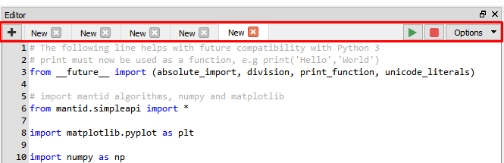
Restrictions and Gotchas
Presenters can GROW large
Can be hard to judge how much should be in the Presenter versus Model
Maybe the View can be split into multiple MVPs
Example: Tabs are in a separate MVP from the rest of the code editor

Slide 10
Restrictions and Gotchas
If you don’t import Framework in the presenter, tests are very fast

Slide 11
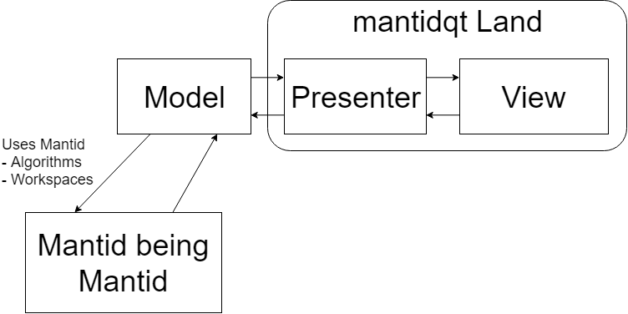
Using MVP in Mantid in Practice
Your widget in mantidqt/widgets/your_widget

Slide 12

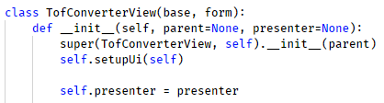


Code example – Presenter is the owner
How to initialise?
Instantiate Presenter
It makes the View and the Model
Cons:
If embedding into another widget, view has to be retrieved separately

Slide 13
Existing MVPs implementations
Table/Matrix workspace displays
Python MVP
mantidqt/widgets/workspacedisplays
Project Recovery
MVP in C++ - ProjectRecoveryView.h
MVP in Python – projectrecoverywidgetview.py
Workspace Presenter
MVP in C++ - WorkspacePresenter.h
AlgorithmProgress (C++ Qt5 Only Widget)
MVP in C++ - AlgorithmProgressWidget.h

Slide 14
Live Qt Connection Debugging

Slide 15
Testing
What is the point of testing?
Make sure things work
Make sure the behaviour does not change unexpectedly
Catch crashes
Library changes / Version differences between OSs
Over time new tests could be added
Keep track of edge cases, and test for them

Slide 16
Ways to test
Unit testing – unittest.TestCase
Presenter
Model
Mock testing – mantid.py3compat.mock
Use the py3compat for easy Py2/3 compatible import
View
Gui testing – GuiTest
Runs an event loop
Can simulate clicks
Can inspect all Qt objects in the application
Can check connections

Slide 17
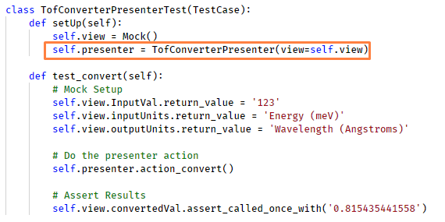
Mocking a view
The view is passed as a parameter to the presenter
This allows easy replacement without ever instantiating the Qt View
The same can be done for the model

Slide 18
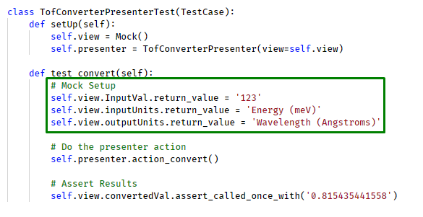
Mocking a view
Benefits
You do not need the original view
Drawbacks
You need to set up the view’s expected return values

Slide 19
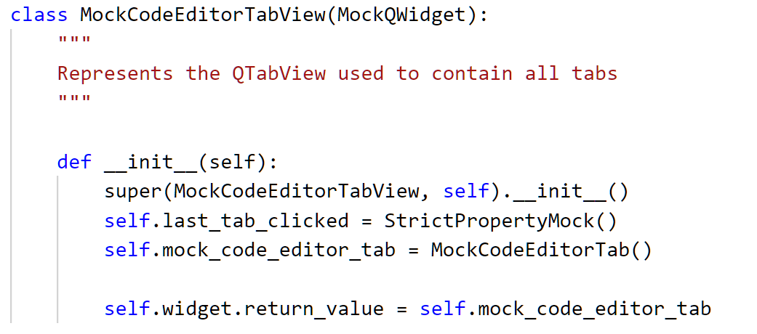
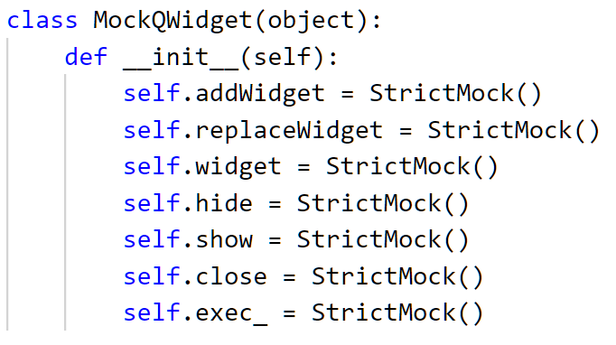
Better mocking of a view
Do not mock out the whole view with
view = Mock()
Mock out the interface of the view

Slide 20
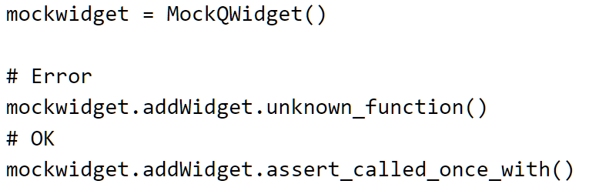
Use StrictMock for mocking functions
StrictMock, StrictPropertyMock are Mantid implementations
Not available in Python’s Mock package
They wrap Python’s Mock class
StrictMock does NOT allow you to call anything that has not been explicitly declared

Slide 21
Using Qt connections in Python
Connecting things
Much easier than C++ with Qt4
Somewhat easier than C++ with Qt5
self.button.clicked.connect(recieving_function)
To see what you get on the recieving_function, you read the Qt docs!

Slide 22
Instructions to start off
All OSs
git clone https://github.com/DTasev/mvp
Windows
Go to a Mantid build
Start command-prompt.bat
Navigate to where you cloned the repo
Type `powershell` if you don’t like `cmd`, the environment will be kept
Linux
Just go

Slide 23
Instructions to start off
Start with `python tof_converter`
Entry point is `__main__.py`
Run with `python __main__.py` or `python .` Inside `mvp/exercise/tof_converter`
It creates the presenter
Which creates the view
Which shows itself

Slide 24
Exercise 1
Make the `Convert` button work using a MVP approach
Use the provided functions from the ‘model.py’ file
Hints:
Add function to presenter
Connect to it
Import the calculation function from the model

Slide 25
Exercise 2
Add the Model class.
Make `Convert` work for all input/output units
Hints:
The class should wrap code already in `model.py`
The presenter should instantiate the model and use it

Slide 26
Exercise 3
Add unit test for the presenter `Convert` action
Mock the View objects that are read by the Presenter
File is `test/test_tof_convert_presenter.py`
Hints:
Refactor the model’s possible inputs/outputs into a list/enum

Slide 27
Exercise 4
Comment the following lines in view.py
`history.setVisible`
`historyLabel.setVisible`
If you start the TofConverter a new widget will show up
It stores the previous conversions. Happens on `Convert` click.
How will you implement the widget?
Extend existing presenter and model
versus
Add new MVP (no view for it)?

Slide 28
Exercise 5
Allow the user to double click an entry in the history to load that value back into the view.
Allow deletion of items with a `-` (minus) button

Slide 29
Exercise 6
Unit test / mock the History widget
Scattering angle and Flight Path should be disabled by default - setDisabled(True)
If Momentum or d-spacing are selected as either input or output enable `scattering angle` field
If Time of Flight is selected, enable `Total flight path` field

Slide 30
References
[1] “Introduction to Model/View/ViewModel pattern for building WPF apps” – John Gossman, https://blogs.msdn.microsoft.com/johngossman/2005/10/08/introduction-to-modelviewviewmodel-pattern-for-building-wpf-apps/
[2] Flux – In depth overview, including video talk, https://facebook.github.io/flux/docs/in-depth-overview.html
[3] Steve Burbeck (1987, updated 1992). “Applications Programming in Smalltalk-80: How to use Model-ViewController (MVC). Available at http://www.dgp.toronto.edu/~dwigdor/teaching/csc2524/2012_F/papers/mvc.pdf
[4] MVP: Model-View-Presenter The Taligent Programming Model for C++ and Java Mike Potel http://www.wildcrest.com/Potel/Portfolio/mvp.pdf
[5] The DCI Architecture: A New Vision of Object-Oriented Programming –Trygve Reenskaug and James Coplien – March 20, 2009.
[6] MVP Introduction, http://developer.mantidproject.org/MVPTutorial/Introduction.html

